Slide 1
Contract Testing – Using Pact
Presented by:
Pavan Kumar Nilagiri

Slide 2
Agenda
Contract Testing
How Does Contract Testing Works
Pact for Contract Testing
Consumer Testing with Pact
Provider Testing with Pact
Sharing Pacts
Pact Broker
Demo

Slide 3
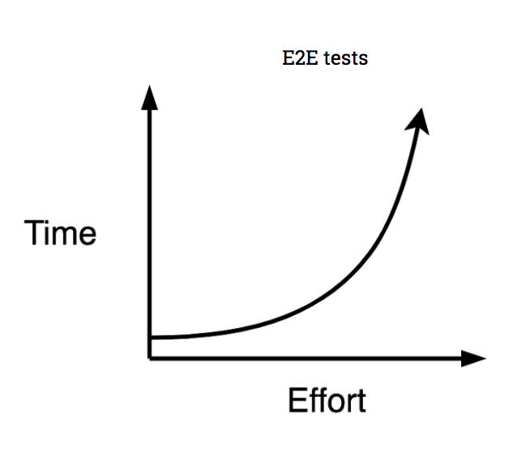
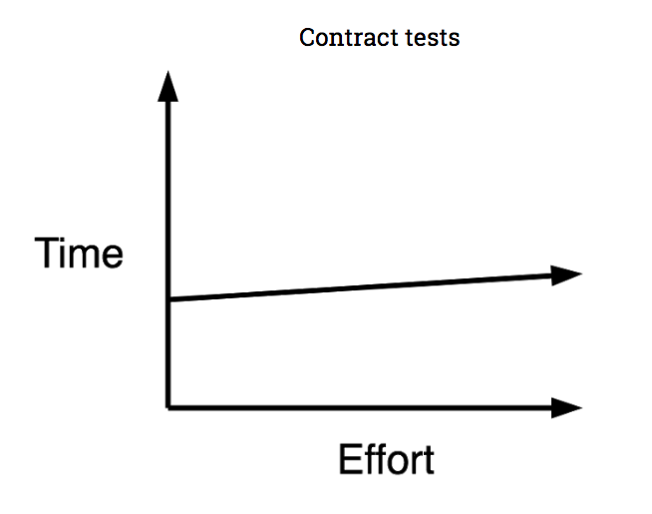
Contract Testing
Focus on contracts or agreements between different components
Detect issues early
Improve collaboration between teams

Slide 4
How Does Contract Testing Works
Create a set of rules or agreements between two services, known as a contract, and then testing that both services comply with these rules.

Slide 5
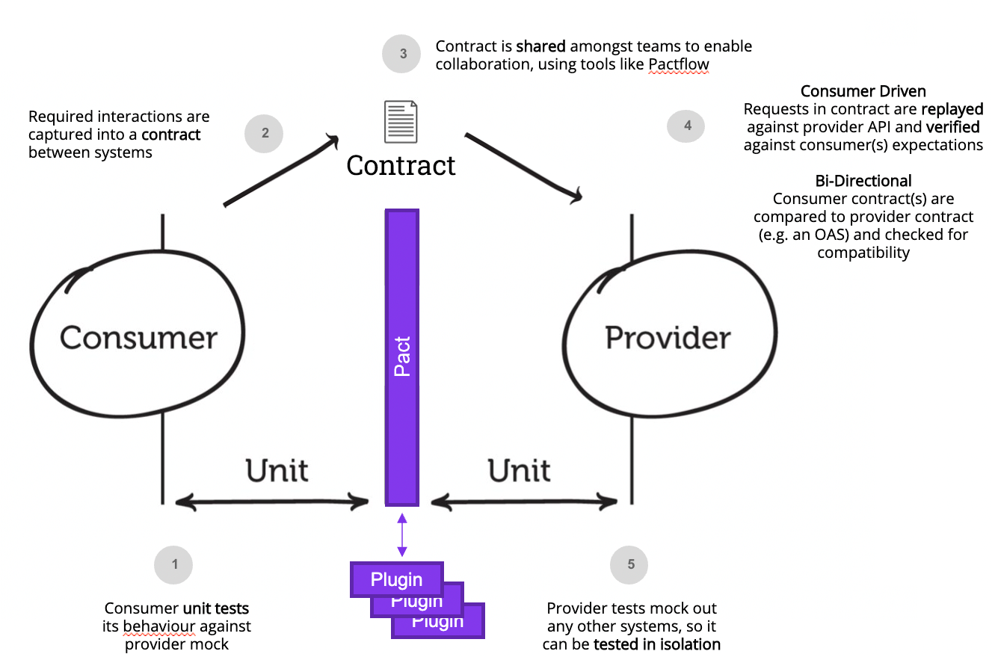
Pact for Contract Testing
Focus on consumer-driven contract testing, which allows teams to work more collaboratively and efficiently
Teams can catch issues earlier in the development process and avoid costly bugs in production
Pact generates tests automatically based on the contracts

Slide 6
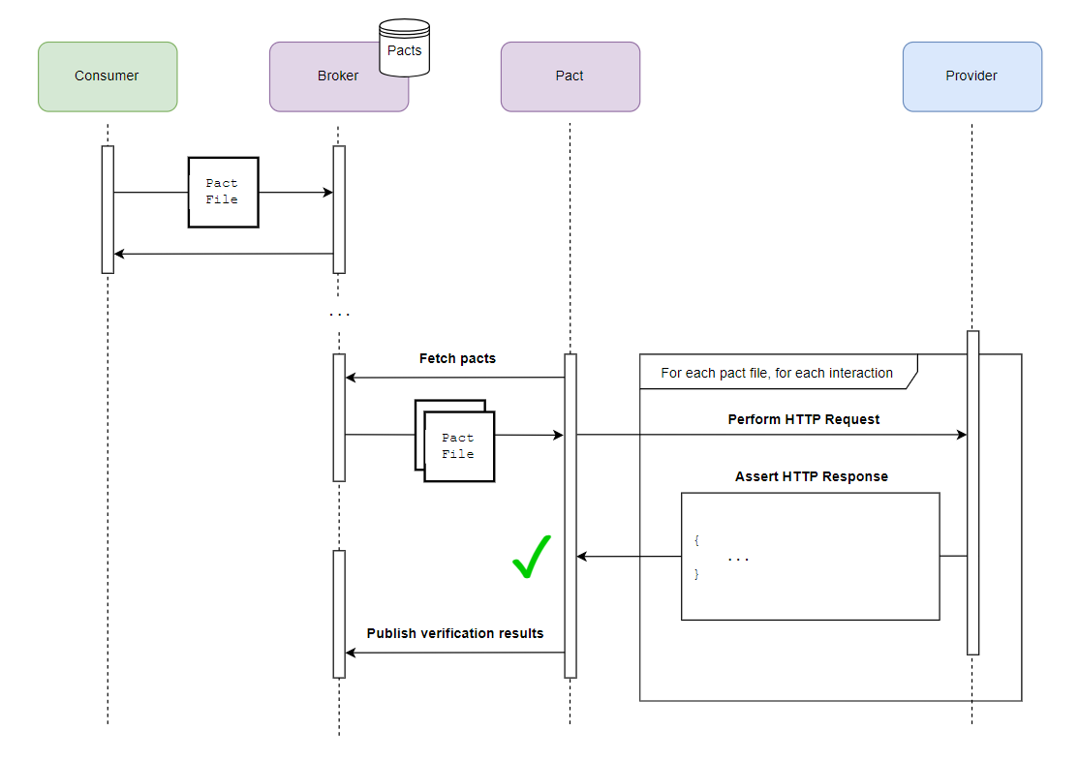
Pact Broker
Easily publish your contracts
Central repository for contracts
You can also set up webhooks to notify teams when a contract has been updated

Slide 7
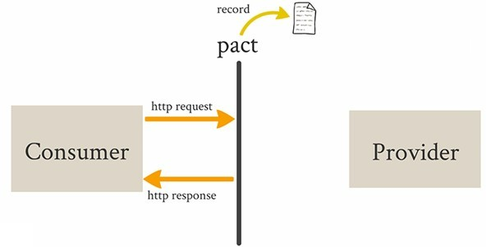
Consumer Testing with Pact

Slide 8
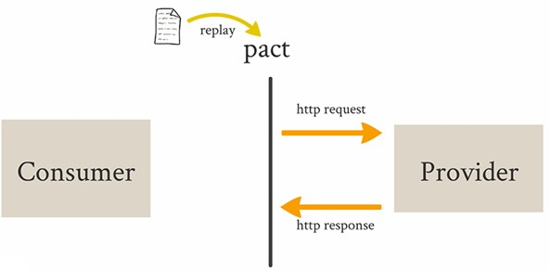
Provider Testing with Pact

Slide 9
Sharing Pacts
Local File System
Pact Broker
Amazon S3
CI Artifacts

Slide 10
Demo

Slide 11
Thank You!

